Slide 1

Quiz game using DBpedia
Intructors: Dr.Do Ba Lam
Student: Nguyen Ngoc Tu - 20251189M
Vu Tuan Kiet - 20242434M

Slide 2
Menu
Introduction
Dbpedia, SPARQL
System development
Conclusion and future work

Slide 3
Introduction

Slide 4

DBpedia
- DBpedia is a community-driven project that extracts structured data from Wikipedia.
It transforms Wikipedia content into RDF format, making it machine-readable and queryable using SPARQL.
Provides access to millions of entities: people, places, organizations, books, movies, etc.
Enables semantic search and linked data exploration.
Ideal for building intelligent applications like quiz games, chatbots, and knowledge graphs.

Slide 5

SPARQL
SPARQL stands for SPARQL Protocol and RDF Query Language.
It is used to query structured data stored in RDF format.
SQL for the Semantic Web.

Slide 6




Development tools

Slide 7
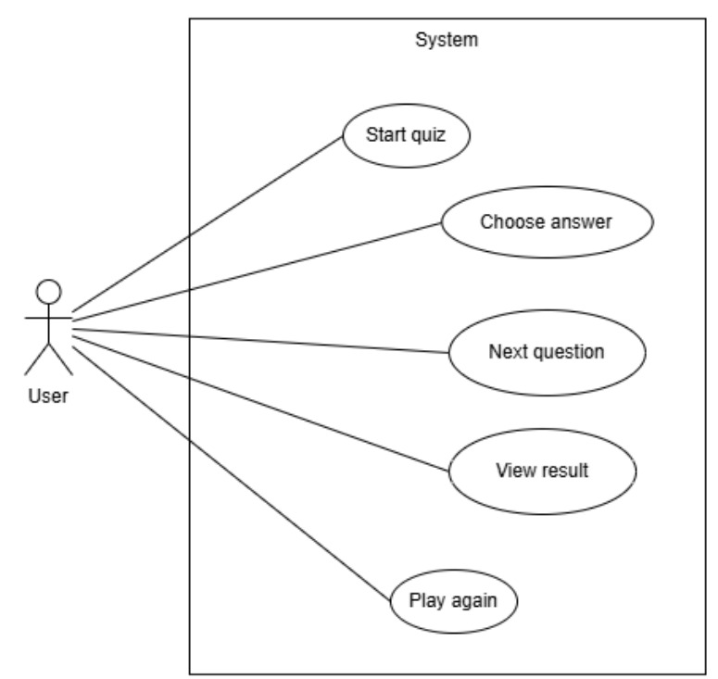
Usecase diagram

Slide 8
System architecture: 3 tier-application
Presentation layer
Business logic layer
Data access layer

Slide 9
SPARQL Query: Information country in Asia
PREFIX dbo: <http://dbpedia.org/ontology/> PREFIX dbp: <http://dbpedia.org/property/> PREFIX rdfs: <http://www.w3.org/2000/01/rdf-schema#> PREFIX dct: <http://purl.org/dc/terms/> PREFIX dbc: <http://dbpedia.org/resource/Category:> SELECT DISTINCT ?country ?countryLabel ?capital ?capitalLabel ?population ?thumbnail WHERE { ?country a dbo:Country ; dct:subject dbc:Countries_in_Asia . ?country rdfs:label ?countryLabel . FILTER ( langMatches(lang(?countryLabel), "EN") ) OPTIONAL { ?country dbo:dissolutionYear ?_diss } FILTER ( !BOUND(?_diss) ) OPTIONAL { { ?country dbo:capital ?capital } UNION { ?country dbp:capital ?capital . FILTER( isIRI(?capital) ) } ?capital rdfs:label ?capitalLabel . FILTER ( langMatches(lang(?capitalLabel), "EN") ) } ORDER BY RAND()

Slide 10
SPARQL Query: Capital city
PREFIX dbo: <http://dbpedia.org/ontology/> PREFIX dbp: <http://dbpedia.org/property/> PREFIX dbr: <http://dbpedia.org/resource/> PREFIX rdfs: <http://www.w3.org/2000/01/rdf-schema#> PREFIX dct: <http://purl.org/dc/terms/> PREFIX dbc: <http://dbpedia.org/resource/Category:> SELECT DISTINCT ?capitalLabel WHERE { ?country a dbo:Country ; dct:subject dbc:Countries_in_Asia . { ?country dbo:capital ?capital } UNION { ?country dbp:capital ?capital . FILTER(isIRI(?capital)) } ?capital rdfs:label ?capitalLabel . FILTER(langMatches(lang(?capitalLabel), "EN")) } ORDER BY RAND()

Slide 11
Conclusion

Slide 12
THANK YOU !

